Slide 1


Slide 2


Slide 3


Slide 4

EMPEROR SHAHAJAN MADE TAJ MAHAJ IN THE MEMORY OF HIS BELOVED WIFE MUMTAZ, WHO IRONICALLY DIED OF PPH DURING HER 14TH CHILDBIRTH IN 1630. WE ALSO LOST BELOVED ACTRESS SMITA PATIL IN MODERN ERA DUE TO PPH.

Slide 5
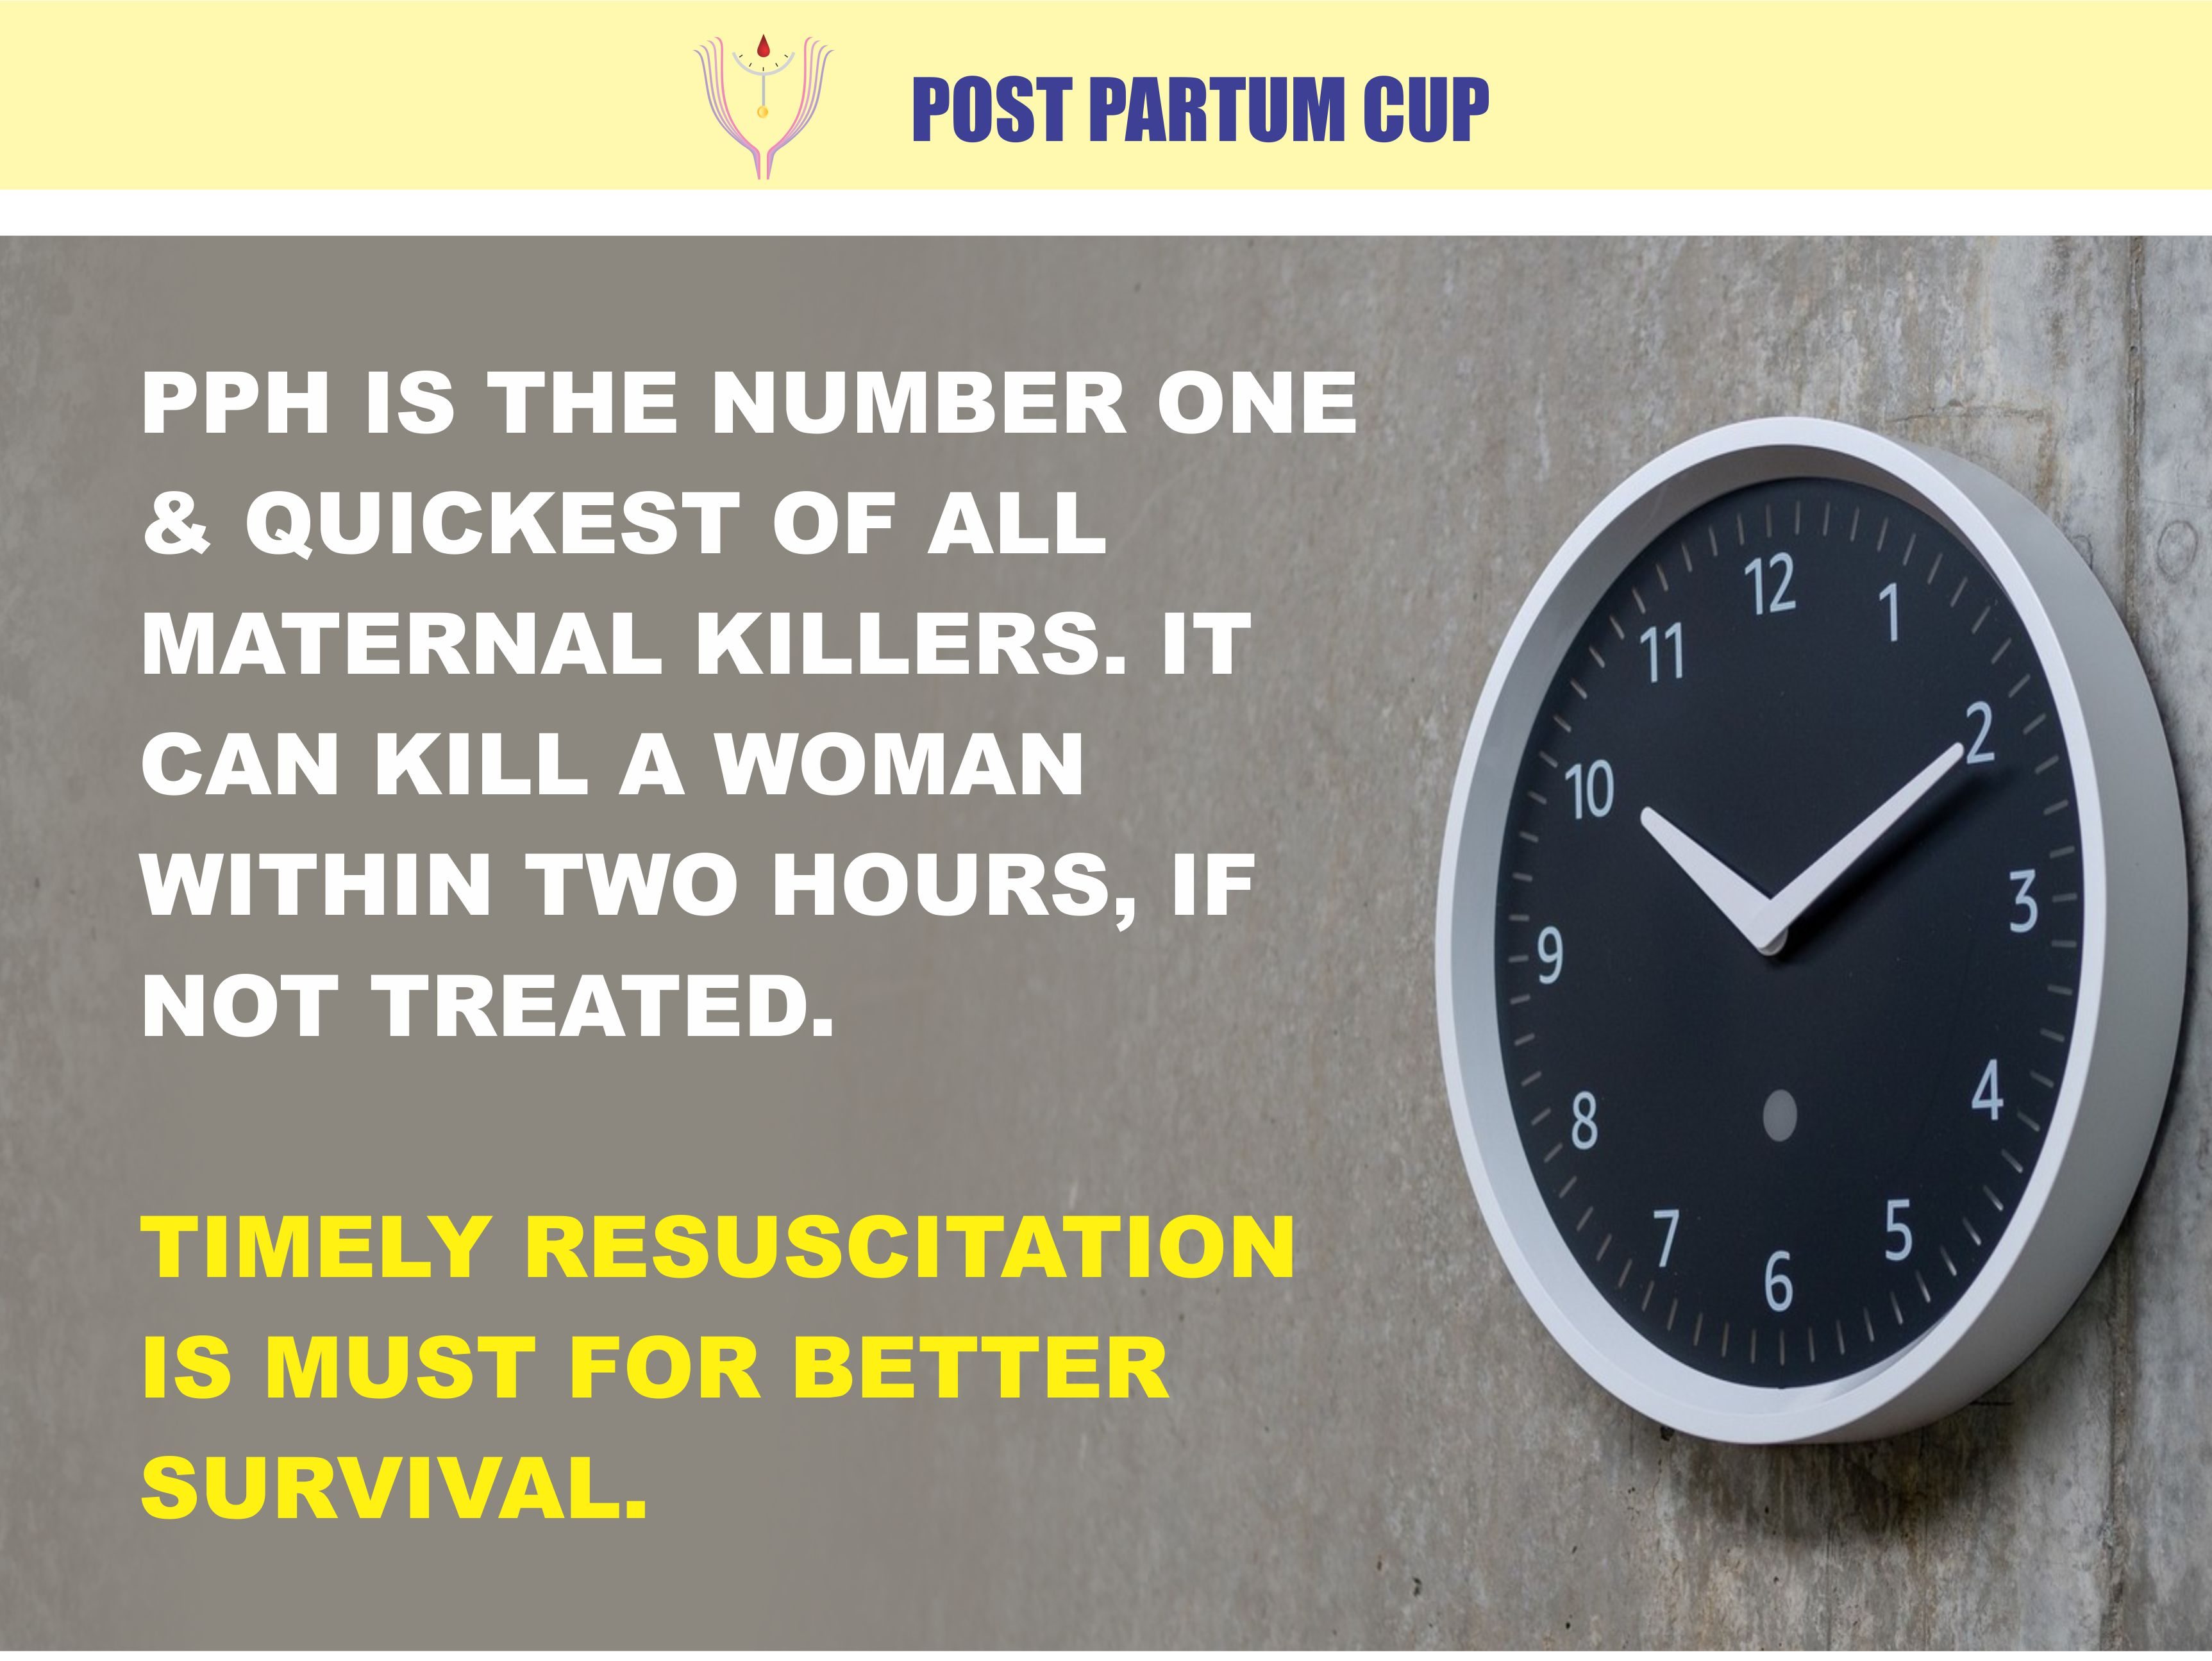

Slide 6
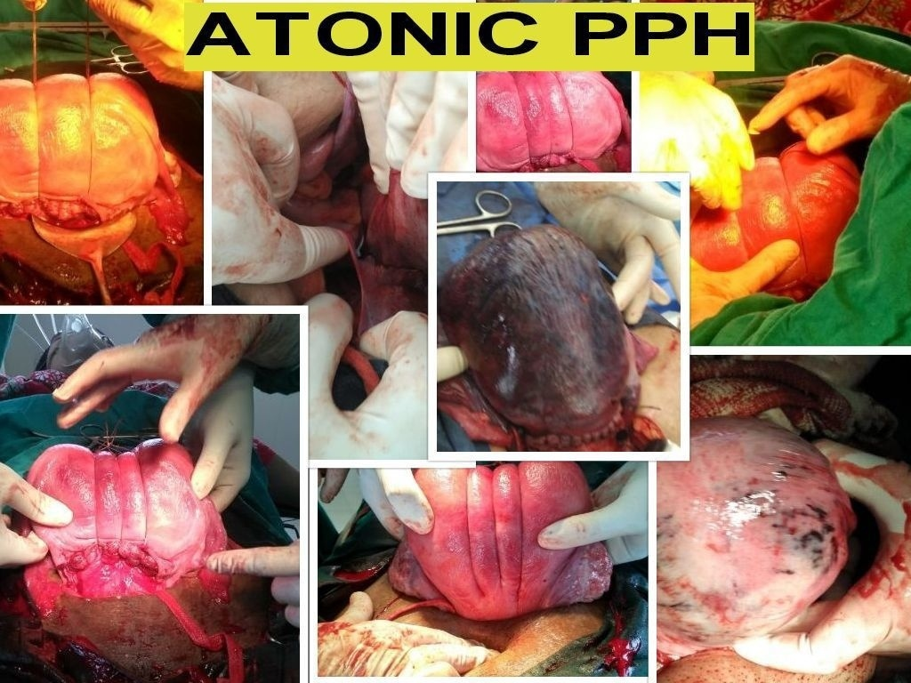

Slide 7
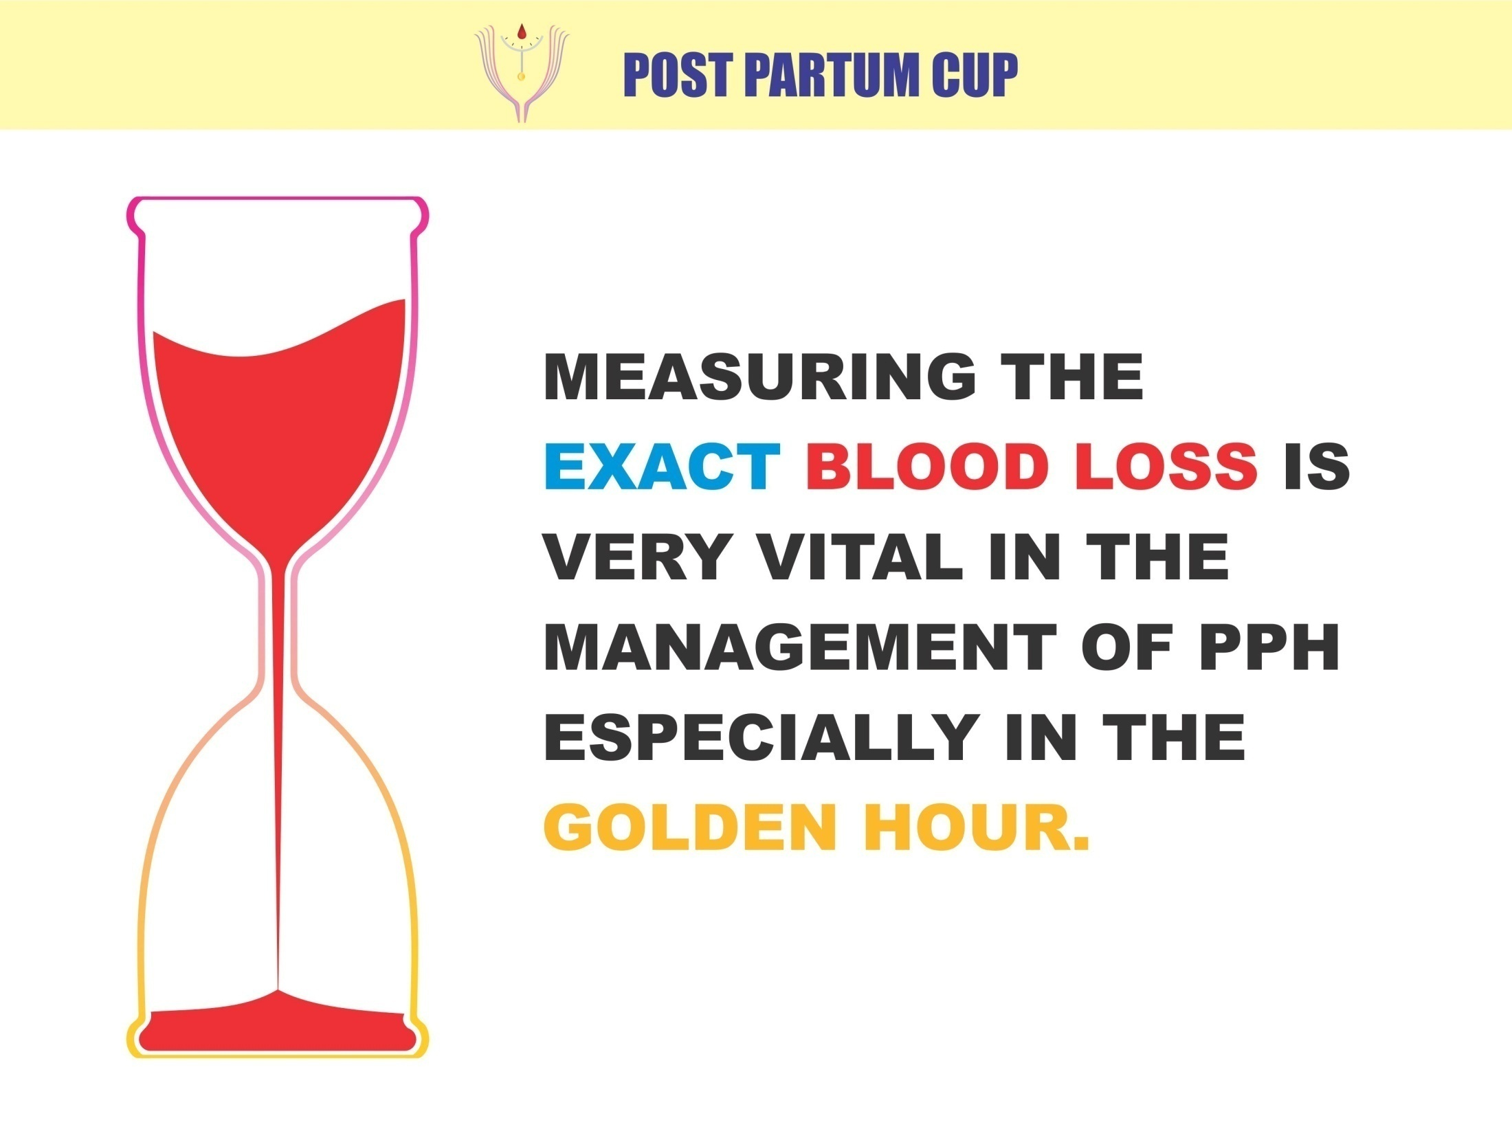

Slide 8
THE IRONY IS THAT NOT A SINGLE METHOD HAS PROVED TO BE THE BEST AND ACCURATE.

Slide 9
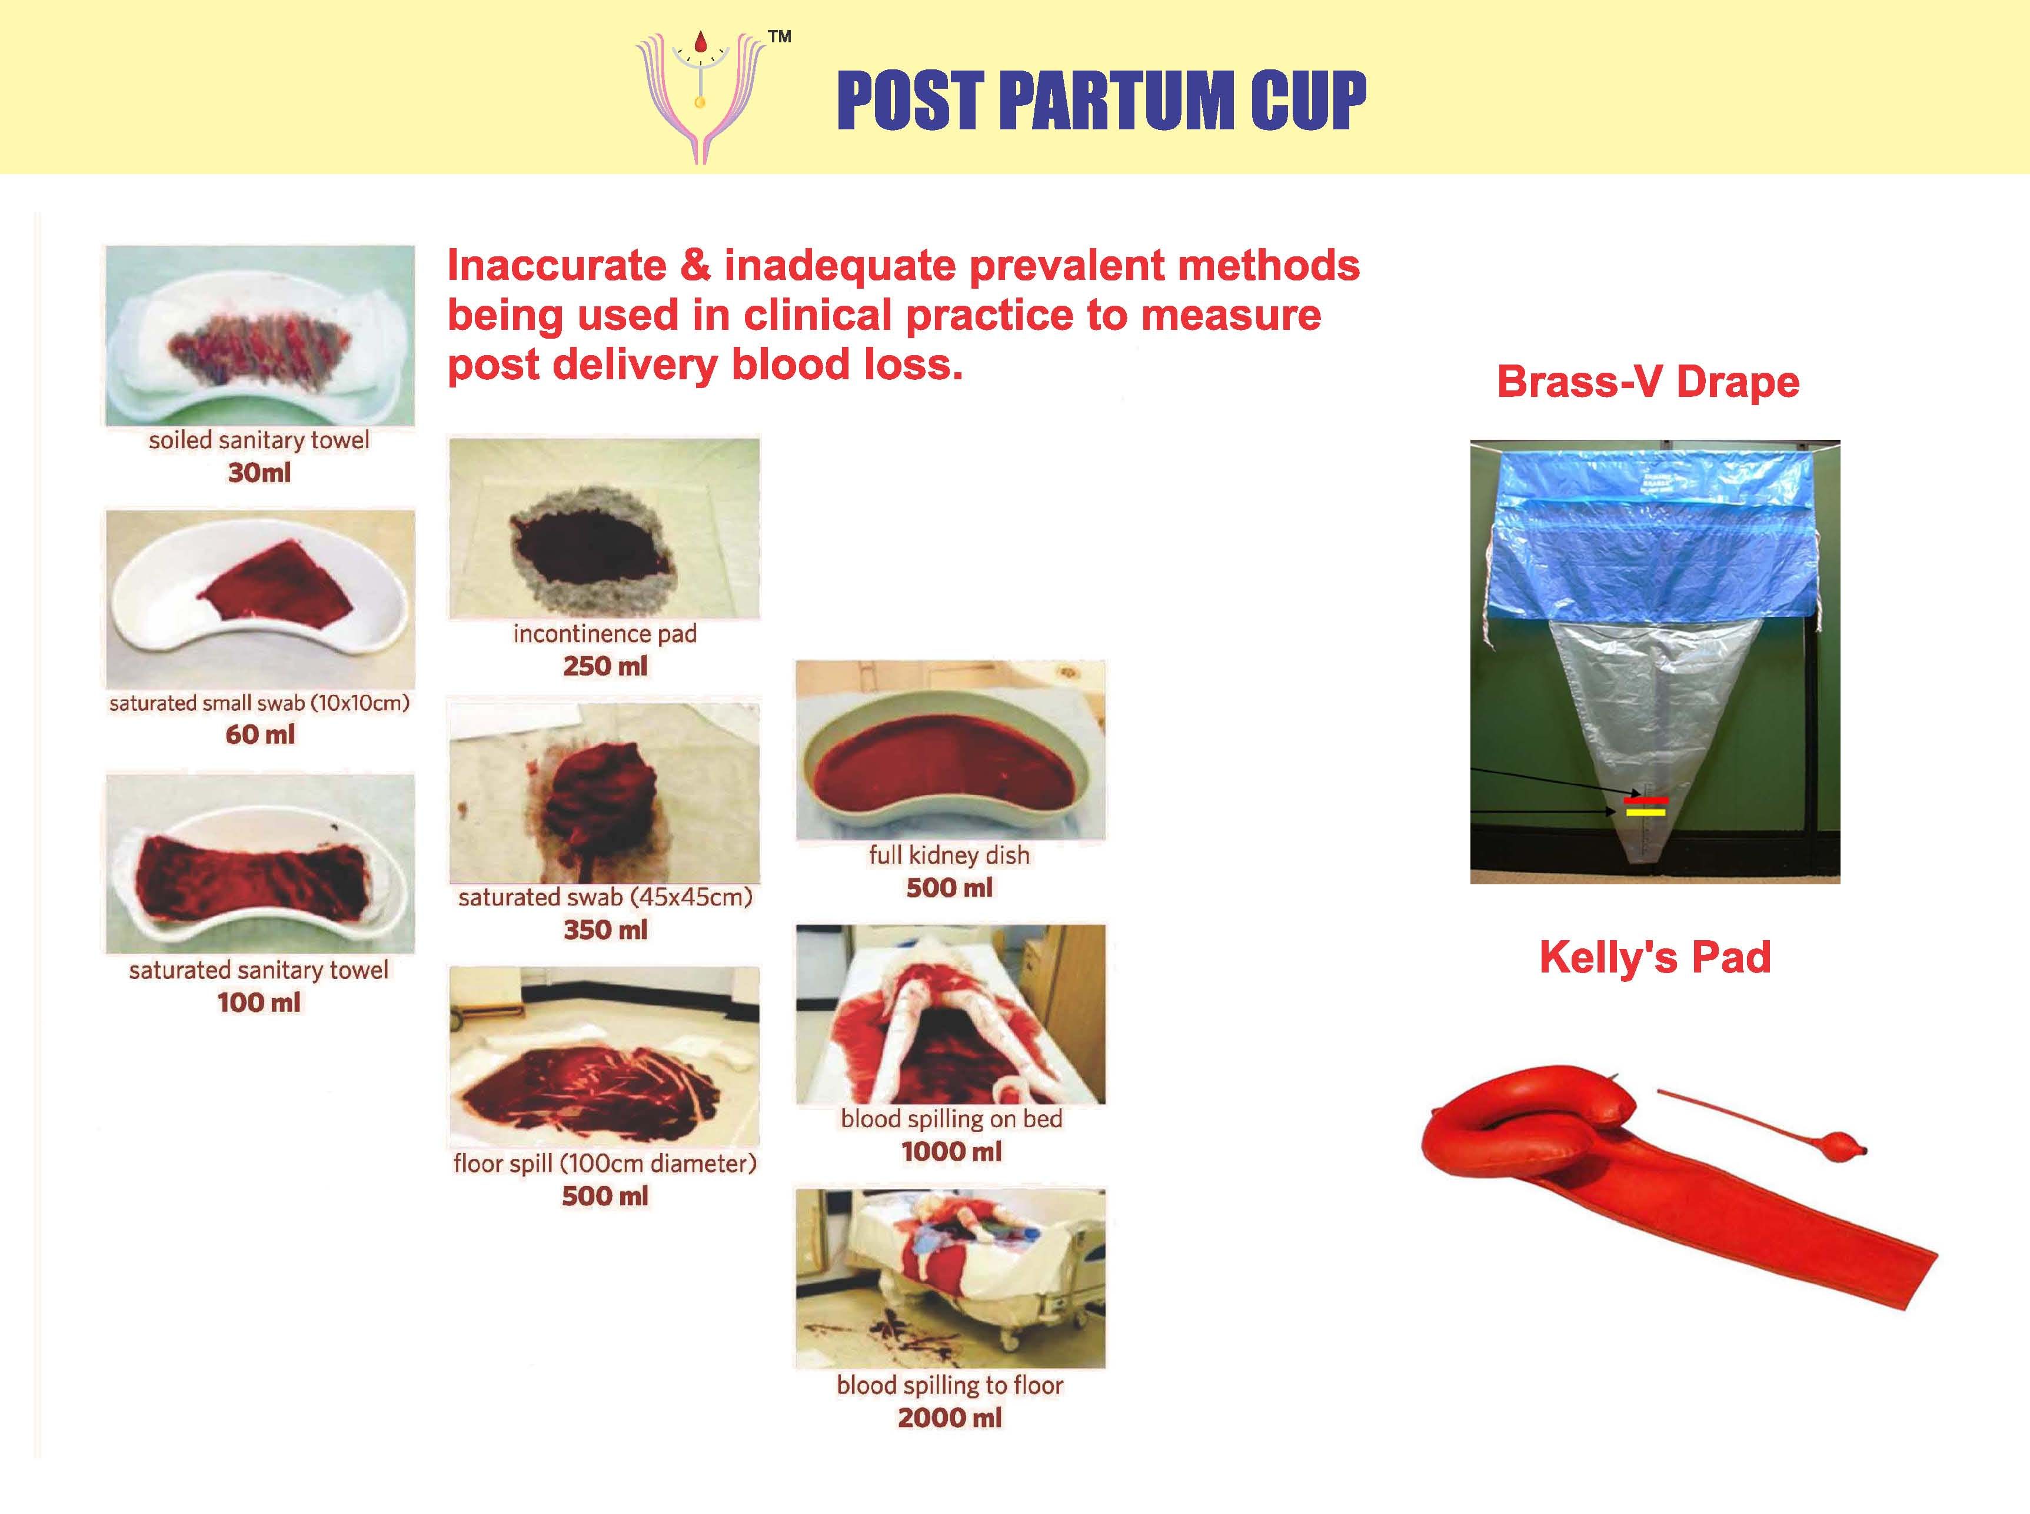

Slide 10
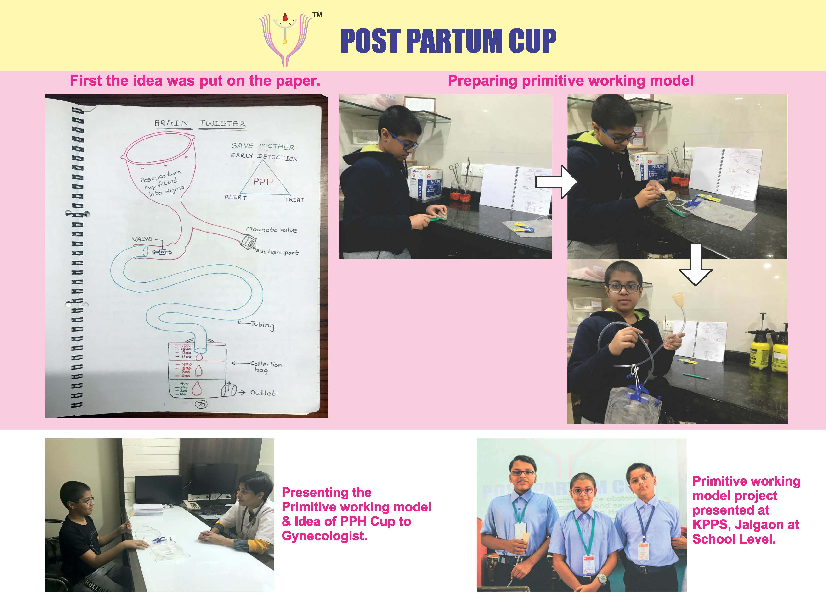

Slide 11
MY REMEDIAL NOVEL INVENTION IS ABOUT EXACT AND REAL TIME MEASUREMENT OF THE BLOOD LOSS AFTER DELIVERY, BY A SIMPLE DEVICE –
“POST PARTUM CUP”

Slide 12
IT IS A SILICONE CUP, SIMPLE, EASY TO USE.

Slide 13
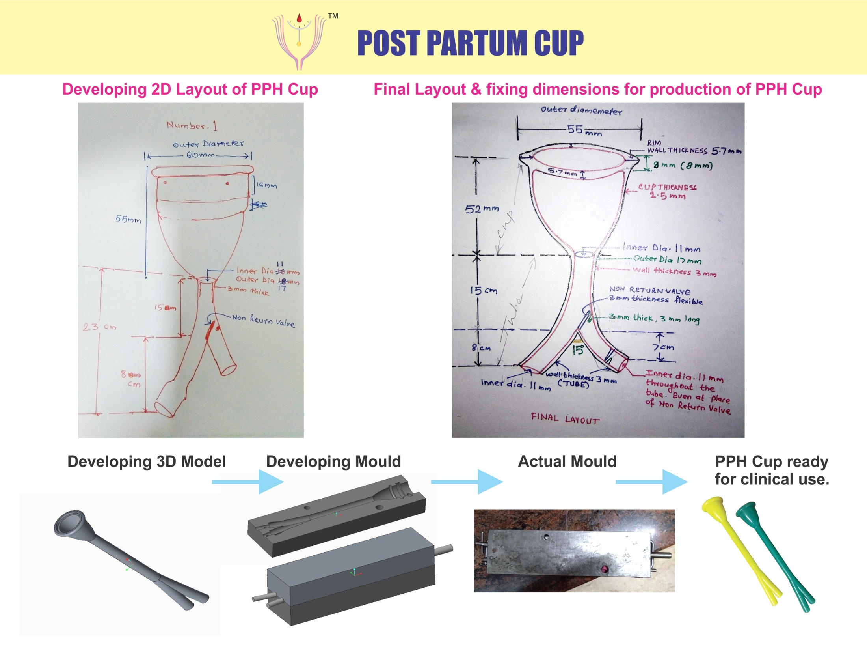

Slide 14


Slide 15
IT IS BEING USED BY MATERNITY HOSPITALS & Medical Colleges SUCCESSFULLY.

Slide 16
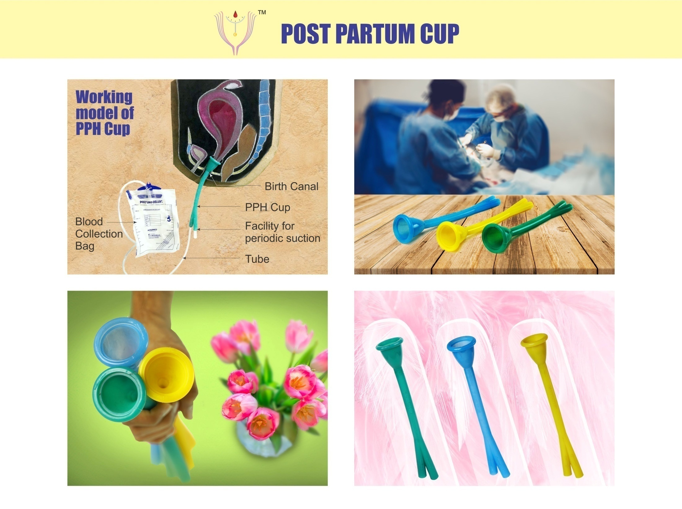

Slide 17
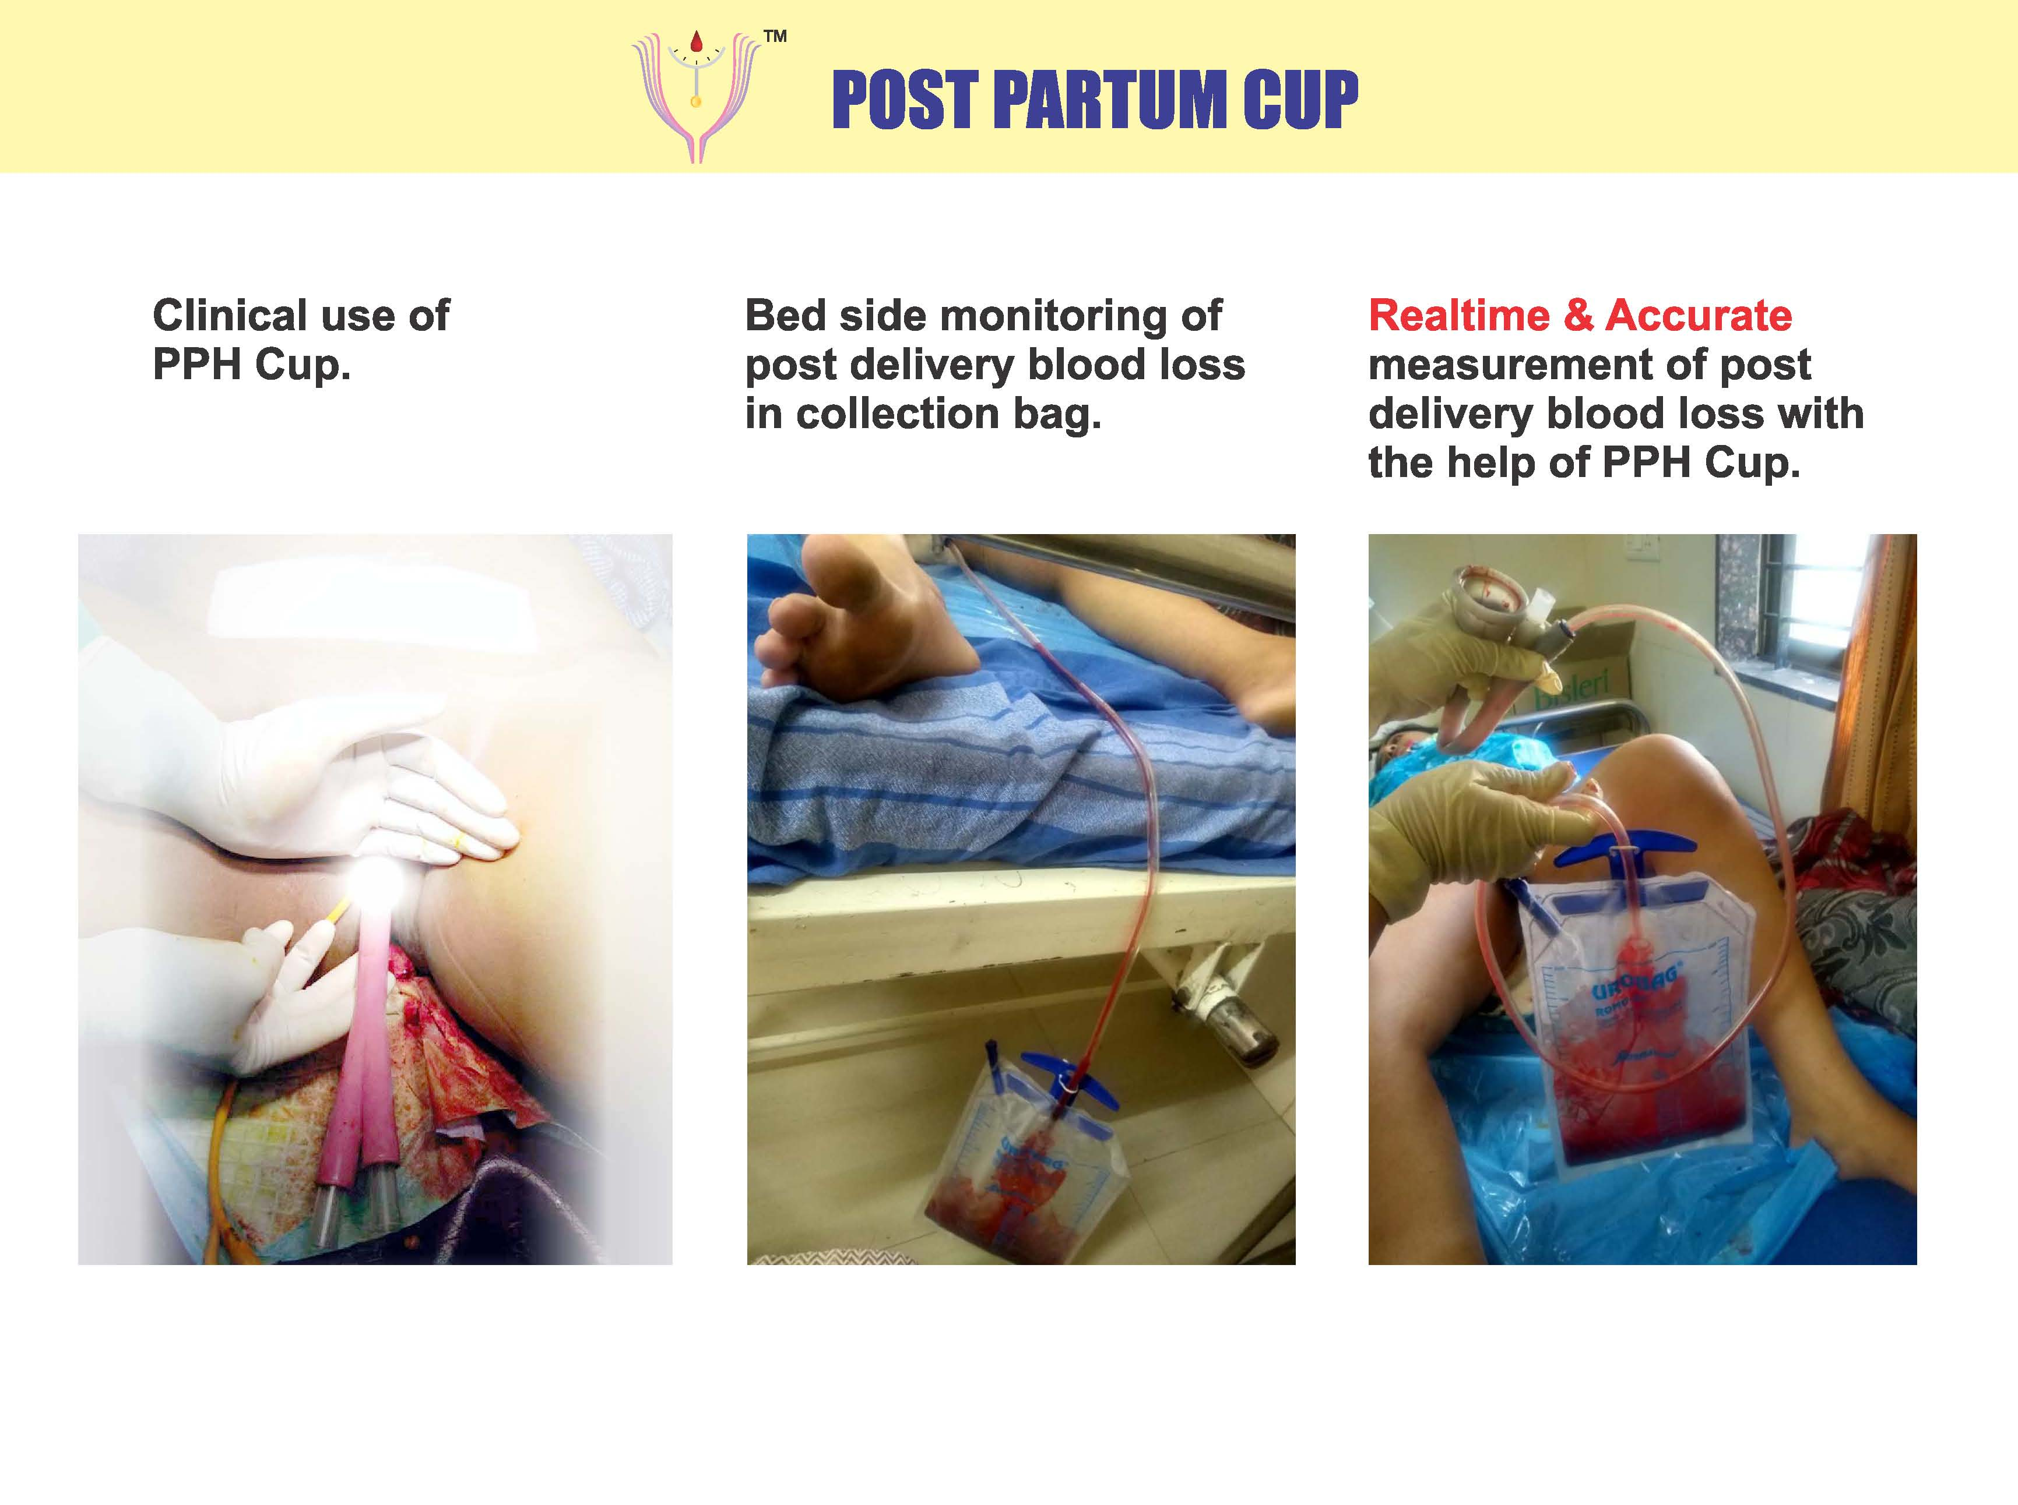

Slide 18
ITS ADVANTAGES ARE CLEARLY ACKNOWLEDGED BY USERS AND ENDORSED BY EXPERTS.
I HOLD THE IP (INTELLECTUAL PROPERTY) RIGHTS OF MY PRODUCT.

Slide 19
THE HEALTH CARE PROVIDERS, OBSTETRICIANS; AROUND THE WORLD, PUBLIC HOSPITALS ARE ITS END USERS.

Slide 20
IT HAS A HUGE MARKET POTENTIAL WITH NO COMPETITORS AT PAR.

Slide 21
I PRAY TO INCORPORATE THIS PPH CUP IN MATERNAL HEALTH SCHEMES OF GOVT. OF INDIA, WHO AND UNICEF.

Slide 22
HENCEFORTH IF YOU COME ACROSS DEATH OF MOTHER DUE TO PPH, YOU SHOULD REMEMBER
“ARCHIT PPH CUP”.

Slide 23

LET’S SEE HOW IT WORKS…….
Please visit the pitch video link…
https://www.youtube.com/watch?v=qkw1uaO0VT4

Slide 24
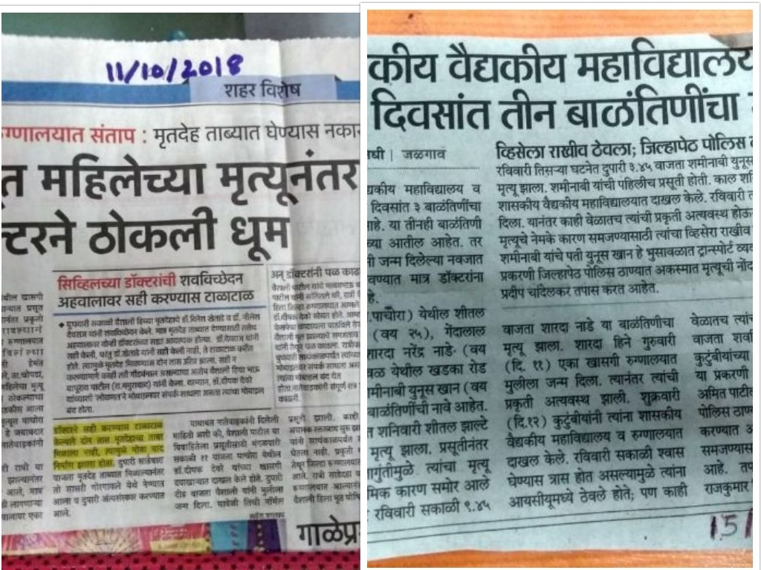

Slide 25


Slide 26
I REQUEST TO GO THROUGH THE WEBSITE www.architpphcup.com THE PICTORIAL JOURNEY, PROJECT ,PROOF OF CONCEPT AND EXPERT’S ENDORSEMENT.

Slide 27
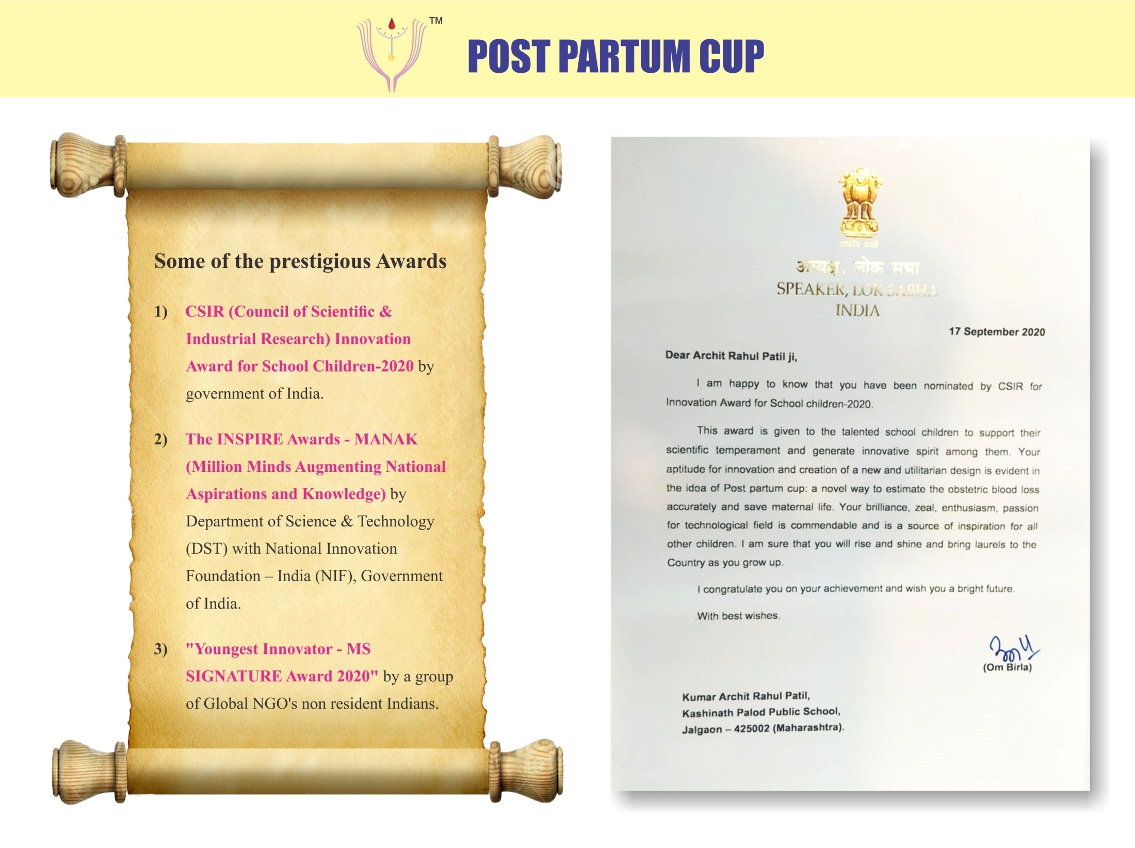

Slide 28
THANK YOU

Slide 29


